Slide 1
Selling cars

Slide 2
Body
We will change the Sass style for the bg-dark to be:
$dark: rgb(31, 27, 46);
Use <body class=“bg-dark”></body>

Slide 3

Navbar
We will take this Navbar: https://getbootstrap.com/docs/5.1/components/navbar/#supported-content
Delete The form.
The first nav item has some paddings and a border
Add more items
Add a new list with ms-auto to move it to the right side
The button has btn-primary
We edited its style in Sass to be: $primary: #fd5631;

Slide 4
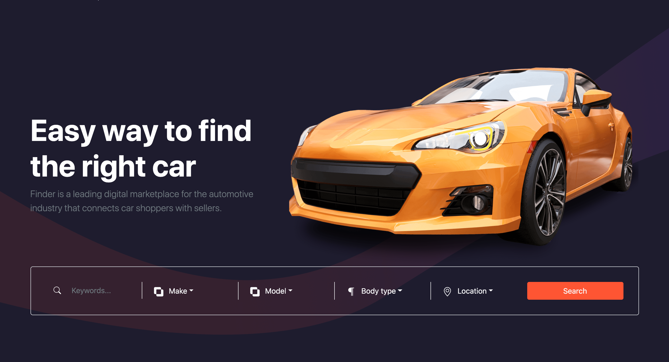
Home Section

Slide 5
Home Section
Let’s first talk about the upper part of the section.
We use section, container, row, col-md-5 and col-md-7 (image)
For the lower part, we use form with row, g-0, p-4, text-white and rounded-3
Inside, we use col-lg-2 and 4(col-lg-2 col-md-3 col-sm-6)
Inside the first column, we use input group (svg and an input tag) with border-end border-light
Rest of the column, we use border-sm-end border-light for the dropdown div element and rounded-3 for the dropdown-menu
We will edit the Sass of the dropdown for: bg, color, border-color, link-color, hover color and hover bg
$dropdown-bg: $dark;
$dropdown-color: white;
$dropdown-border-color: rgba(255, 255, 255, 0.473);
$dropdown-link-color: white;
$dropdown-link-hover-color: rgba(255, 255, 255, 0.493) ;
$dropdown-link-hover-bg: $dark;
And finally the button with submit with <hr class="d-lg-none my-2"> before it

Slide 6
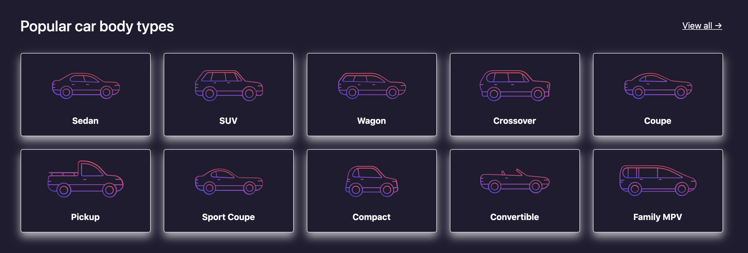
Car body section

Slide 7
Car body section
We use section, container.
For the titles, we use <div class="d-sm-flex align-items-center justify-content-between mb-3 mb-sm-4 pb-sm-2">, a header for the title and <a> tag for the view link
Then for the cards, we use row row-cols-2 row-cols-sm-3 row-cols-md-4 row-cols-lg-5 g-2 g-md-4, col class, cards, images with 160px width and <a> with stretched link
Add shadow class and edit it in Sass to be: $box-shadow: 0 .5rem 1rem rgba(255, 255, 255, 0.678);

Slide 8
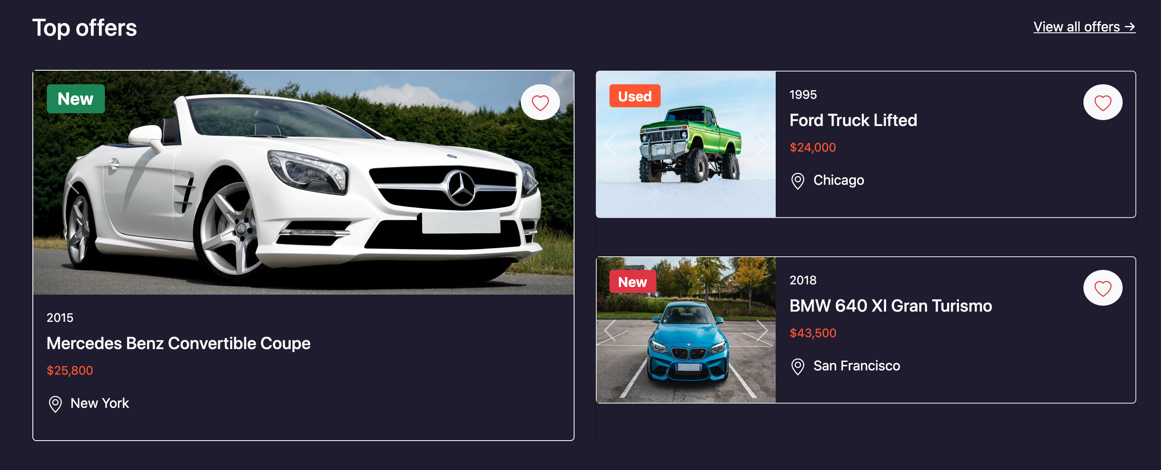
Top offers

Slide 9
Top offers
We use section, container, same method for the headers, row, 2(col-lg-6) with custom cards
Let’s talk about the first card.
The card has border-1 light, rounded-3, bg-transparent, the first card has h-100 and the rest have h-50
The card has already position: relative; We will add a header with position-absolute, m-3 and z-index: 1000; Don’t make it more than 1030 because the navbar for fixed has 1030
We will add a tooltip and give it: btn btn-light rounded-circle position-absolute end-0 m-3 py-2 and same z-index as the header
We will add rounded-3 to the carousel and some content as a card body

Slide 10
Top offers
Let’s talk about the last two cards
We will use the horizontal card from: https://getbootstrap.com/docs/5.1/components/card/#horizontal with border and rounded-3
The medium col will be large
We will add the same method for tooltip and header
For the carousel, we can use h-100 for carousel-inner, item and images to make sure that the image covers 100% of the height of the card
Add some content
Do the same method to the third card

Slide 11

Brands section
We use section, container with py-2 py-sm-3, row with g-2 g-sm-4, 12 (col-3 col-sm-2 col-xl-1 mb-4 pb-2) with <a class="mx-auto" href="#">

Slide 12
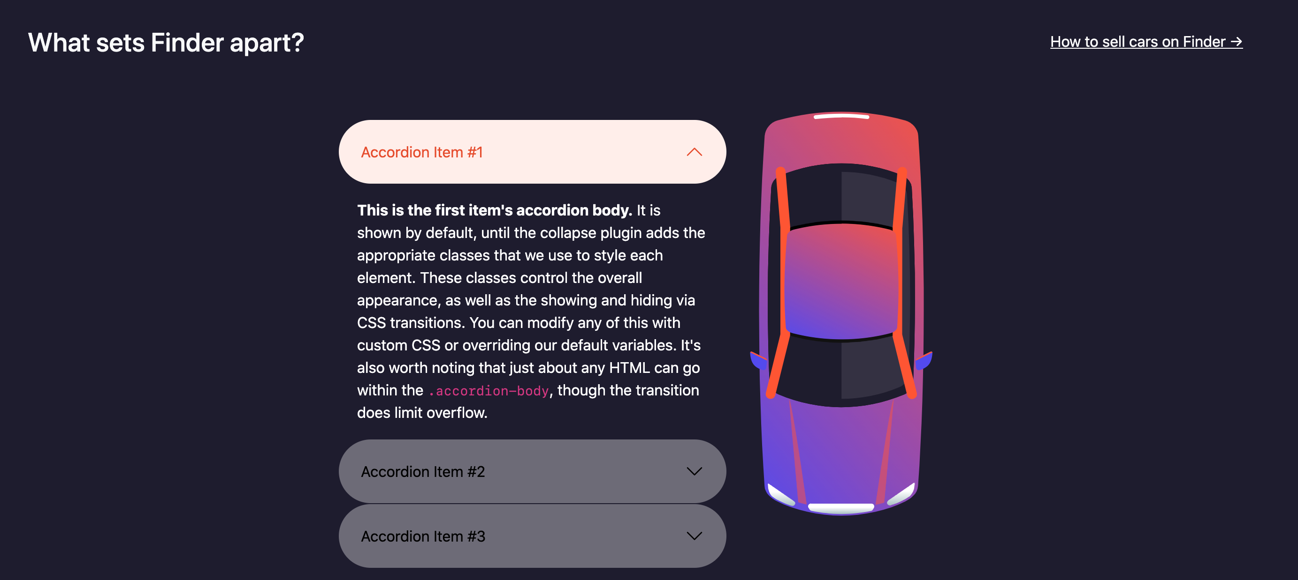
Finder section

Slide 13
Finder section
We use section, container with pt-4 pt-md-5, same method for the headers, row with align-items-center justify-content-center, col-md-4 and col-md-2 text-center d-md-block d-none for the image
For the accordion, We will copy it from: https://getbootstrap.com/docs/5.1/components/accordion/#example We will edit its Style with Sass and add some classes
Let’s start with classes:
Add rounded-pill and p-4 to the buttons
Let’s go to Sass: https://getbootstrap.com/docs/5.1/components/accordion/#sass

Slide 14
Finder section
We will change:
1- bg to be: $accordion-bg: transparent;
$accordion-border-color: transparent ;
$accordion-border-radius: 0px;
$accordion-button-color: black;
$accordion-button-bg: rgba(255, 255, 255, 0.349);

Slide 15

App section

Slide 16
App section
We will add section, container with my-5, row align-items-center pb-5, col-md-7 col-lg-6 col-xl-5 text-center text-md-start mb-4 mb-md-0 for the content and col-md-5 col-lg-6 text-center for the image
We will edit the button info to add the links
We will make $info: rgba(69, 64, 86, 0.765);

Slide 17
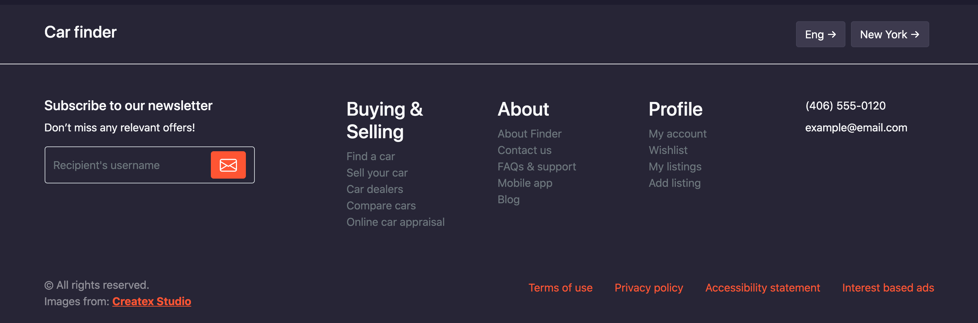
Footer

Slide 18
Footer
We add footer with background-color: rgba(255,255,255,.04);, <div class="border-bottom border-light py-4"> for the upper part of the footer, container with d-sm-flex align-items-center justify-content-between
<a> tag with d-inline-block link-light text-decoration-none for the finder
Div with d-flex pt-3 pt-sm-0 for the right side
Inside the right side, two spans with <a> tag (btn btn-info me-2 text-decoration-none)
For the lower part, we use container with pt-4 pb-3 pt-lg-5 pb-lg-4
row pt-2 pt-lg-0,
One col-lg-3 pb-2 mb-4 and three col-lg-2 col-md-3 col-sm-6 mb-2 mb-sm-4
For the subscribe form, we use input-group
The input has border-end-0 bg-transparent text-white
The text has border-start-0 bg-transparent

Slide 19
Footer
The last column has col-xl-2 col-lg-3 col-sm-6 col-md-3 mb-2 mb-sm-4
For the copyright, we use container with d-lg-flex align-items-center justify-content-between pb-3
Then the nesting method for the right side with <div class=” d-flex flex-wrap justify-content-center order-lg-2 mb-3”> and some <a> tags
Then we will add p tag with text-center text-lg-start order-lg-1 mb-lg-0

